Slide 1




STREAMLINING INTERACTIVE PHARMA MARKETING
JETA SAGE
AWS BUSINESS CASE COMPETITION
April 2024

Slide 2






About Us
Amarnath Amarnath Computer Science 2024
Toluwani C. Olukanni Electrical and Computer Engineering 2025
Jasmin M. Sackey Business Management 2026
Eliezer M. Aboagye Computer Science 2025

Slide 3
Table Of Content
01.
The Challenge
02.
Things To Know
03.
The Proposed Solution
04.
Adoption Roadmap
05.
Pitch Deck

Slide 4
The Challenge
Personalized advertising has become a standard practice in the pharmaceutical industry, but the current approaches often fall short.
This marketing is irrelevant and undesirable for individuals.
This leads to user frustration and lack of engagement.
In addition, the regulations and restrictions imposed on pharma marketing make it challenging to cater personalized ads to different demographics easily.
Lastly, measuring the effectiveness of pharma marketing campaigns is complex and biased.

Slide 5
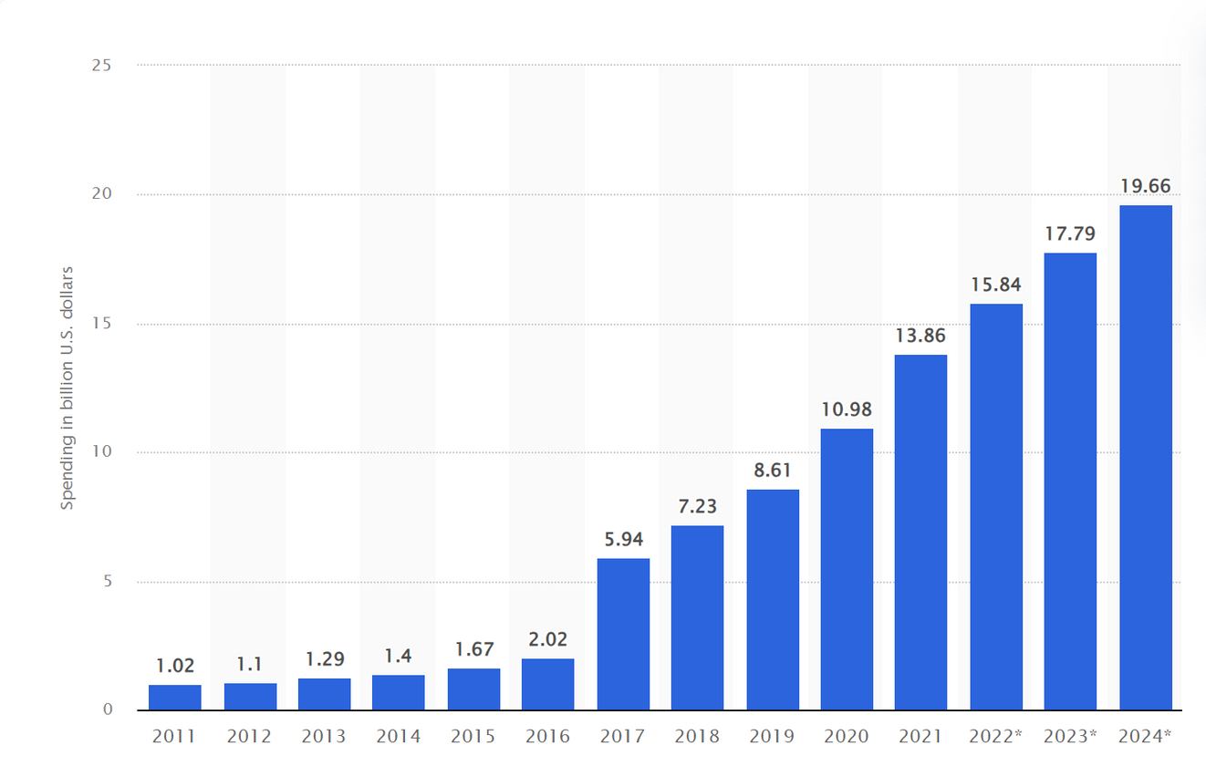
Things To Know
Healthcare and pharmaceutical industry digital advertising spending in the United States from 2011 to 2024

Slide 6
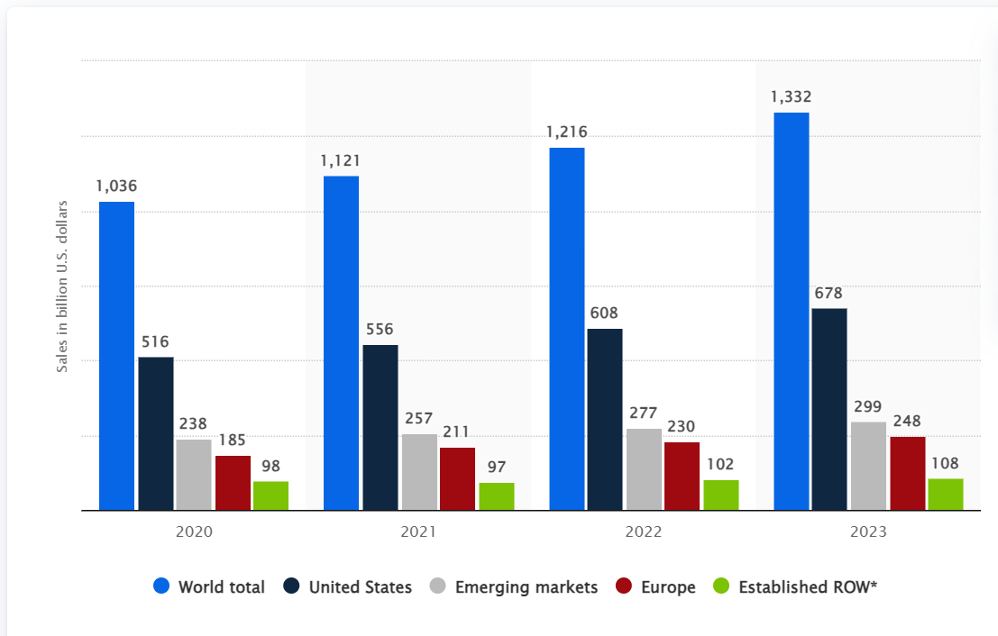
Things To Know
Global pharmaceutical sales from 2020 to 2023, by region

Slide 7
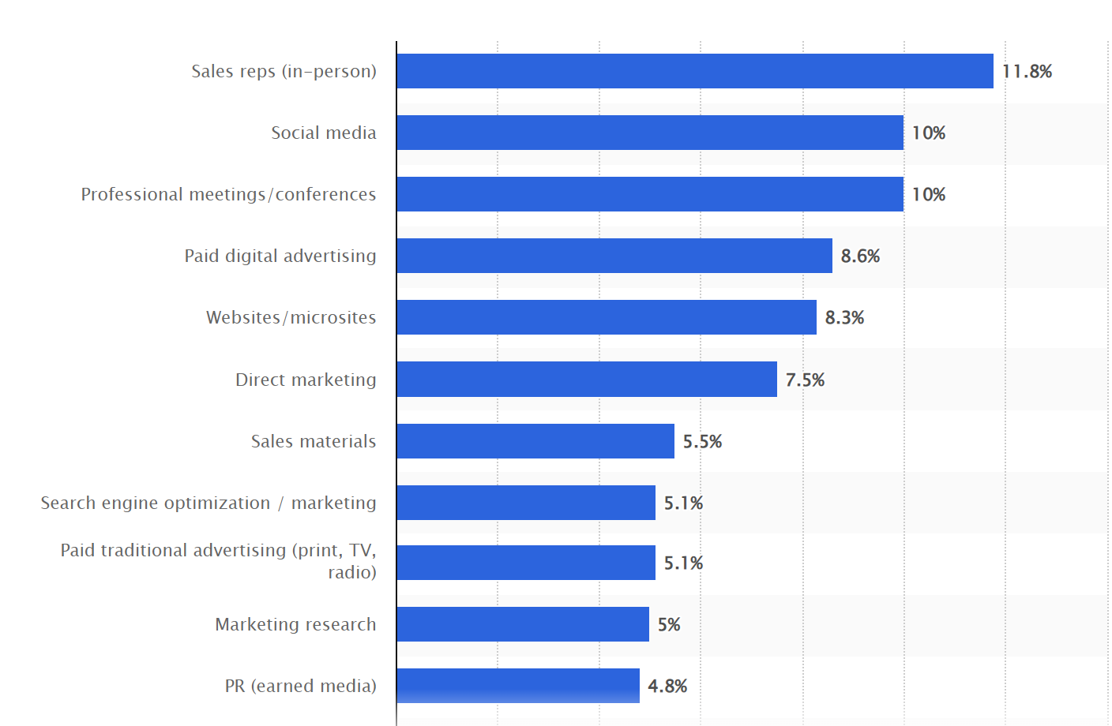
Things To Know
Distribution of healthcare companies' marketing budgets in the United States as of March 2023, by channel

Slide 8
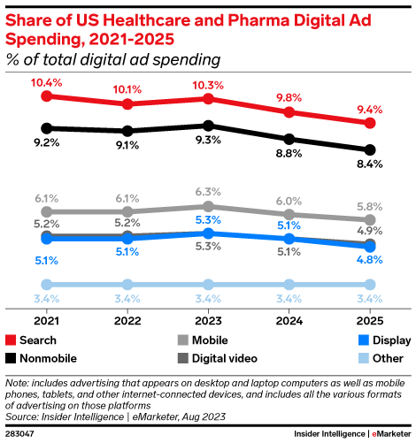
Things To Know

Slide 9
The Proposed Solution
Streamlined AI models generate personalized advertisements from data collection to deployment and market impact analysis.
Interactive, personalized advertisements cater to healthcare professionals and mainstream consumers, offering real-time engagement and appointment bookings.
Ads include a chatbot with detailed medication information for guidance and referrals to company representatives.
The interactive model aims to cut marketing costs by 8% and boost sales by 7%

Slide 10

MVP
Sources of Data
Sources of Data
Food and Drug Administration Regulations from chosen demographic.
Previously approved marketing materials.
Company’s customer data.
Pharmaceutical product description, verified by a health care professional.
Geographical or situational data, based on the location of a specific demographic.
Food and Drug Administration Regulations from chosen demographic.
Previously approved marketing materials.
Company’s customer data.
Pharmaceutical product description, verified by a health care professional.
Geographical or situational data, based on the location of a specific demographic.
Food and Drug Administration Regulations from chosen demographic.
Previously approved marketing materials.
Company’s customer data.
Pharmaceutical product description, verified by a health care professional.
Geographical or situational data, based on the location of a specific demographic.

Slide 11

MVP
Amazon Comprehend
Amazon Redshift
Amazon Bedrock
Amazon Rekognition
Amazon Quicksight
Outsourced AI models
Outsourced AI models
Personalized Social Media Advertisements
Poster Ads
Billboard Ads
Email Ads
Outcome from product
Outcome from product

Slide 12


Primary concerns
Inaccurate Models and Hallucinations
Allow more human oversight and check processes
Ensure high quality data for training.
Intellectual Property (IP) Infringement and Data Privacy:
Data Anonymization
Ironclad contracts
Train model on proprietary data

Slide 13


Primary concerns
Regulatory Compliance
Maintain human supervision
Embed compliance checks and quality control directly in AI architecture.
Rise of Ad blockers
Partner with major social media platforms
Distribute through other available media

Slide 14











Product Architecture
Sales and Marketing Teams
Create dashboards and visualize market impact
Pass Data
Process data and extract info
Reinforce content by passing data from market performance
Amazon Redshift
Amazon Quicksight
Pass market impact data, and statistics
Data from various sources
Amazon Comprehend
Identify important data for prompting
Final Quality control check before deployment
Social Media
Analysts/Prompt Engineers
Quality Control Analyst
Refine the prompt and pass to Gen AI
Use CV to check for inappropriate content
Consumers/health care professionals
Create Marketing materials/ personalized ads
Amazon Bedrock
(Content Generator)
Amazon Rekognition
(Quality Control)

Slide 15





ADOPTION ROADMAP
Scaling Phase
1
Establish the models across different marketing regions.
Expand training of marketing teams to be proficient in using the Gen AI Technology.
Get mechanisms for monitoring and evaluating the long-term impact of the performance of Gen AI on pharmaceutical marketing.
PHASE
Preparation Phase
Identify the target audience.
Partner with Amazon and pharmaceuticals.
Collect data on existing structures and train the Gen AI Model.
PHASE
2

Slide 16
ADOPTION ROADMAP
3
Improvement Phase
PHASE
Conduct regular surveys to assess the solution’s effectiveness.
Explore the possibilities of integrating the solution with emerging technologies.
Refine algorithms to improve the model’s performance and compliance with regulations
Marketing Phase
Offer discount pricing and deals for early adopters.
Offer training and support to company staff to help with the transition to using Gen AI technology.
Provide testimonials and success stories from early adopters to emphasize the benefits of using Gen AI for Pharma Marketing.
PHASE
4

Slide 17




Why JETA Sage?
AI integrated personalized Interactive ad tailored for individuals needs
Pro-human approach: AI supplements tasks, validated by human experts.
Constantly improving with reinforcement feedback loop.
Scalable and flexible for businesses of all sizes and industries (energy, healthcare etc)

Slide 18
References
https://www.raps.org/news-and-articles/news-articles/2022/12/us-social-media-promotion-violation-trends-in-a-po
https://milkeninstitute.org/article/tech-regulation-digest-fda-drug-marketing
https://publichealth.jhu.edu/2023/spending-on-consumer-advertising-for-top-selling-prescription-drugs-in-us-favors-those-with-low-added-benefit
https://www.statista.com/topics/8415/pharma-and-healthcare-industry-advertising-in-the-us/#topicOverview https://aws.amazon.com/
https://basis.com/blog/2024-trends-for-healthcare-and-pharmaceutical-marketers
https://www.statista.com/statistics/235966/us-healthcare-and-pharmaceutical-industry-online-ad-spending/
https://www.emarketer.com/content/us-healthcare-pharma-digital-ad-spending-2023

Slide 19
Q&A

Slide 20
Thank You

